Slide 1


Department of English and Foreign Languages
SRM Institute of science and Technology

Slide 2

The word 'essay' derives from the Latin word 'exagium', meaning the presentation of a case.
The Frenchman Michel de Montaigne, born in 1533, was the first author to describe his works of writing as essays.
An essay is a focused piece of writing that develops an argument or narrative based on evidence, analysis and interpretation.

Slide 3

Argumentative essays
Expository essays
Narrative essays
Descriptive essays
Textual analysis essays

Slide 4

Unity
Order
Brevity
Style
Personal touch
An essay must have a unity, treating in orderly manner of one subject and the style should be simple, direct and clear.

Slide 5

Essay type | Skills tested | Example prompt
Argumentative | Forming an opinion via research Building an evidence-based argument | Has the rise of the internet had a positive or negative impact on education?
Expository | Knowledge of a topic Communicating information clearly | Explain how the invention of the printing press changed European society in the 15th century.
Narrative | Creative language use Presenting a compelling narrative | Write about an experience where you learned something about yourself.
Descriptive | Creative language use Describing sensory details | Describe an object that has sentimental value for you.

Slide 6

Outlining
An essay outline is a way of planning the structure of your essay before you start writing.
It involves writing quick summary sentences or phrases for every point you will cover in each paragraph, giving you a picture of how your argument will unfold.

Slide 7

Organizing your material
you need to shape your ideas into a structured argument.
Tips for Organization
Arguments usually proceed from the simplest claim to the most complex
Give the background early
Define terms as needed

Slide 8

A good introduction paragraph is both engaging and informative. The main goals of your introduction are to:
Catch your reader’s attention and interest.
Give context and background on your topic.
Set up the focus and purpose of your essay.
Thesis statement
The central argument of your paper or essay.
It is just one or two sentences long, and usually appears near the end of your introduction.
Example:
To slow the effects of climate change, the US should immediately begin phasing out fossil fuels and invest in a Green New Deal; as the world’s most powerful economy, it can take a global lead in reducing carbon emissions.

Slide 9

Begin with a rough outline of the organization.
A good working thesis statement and working topic sentences will help keep you on track as you write.
Condense all of the paragraphs into only their topic sentences and read them one at a time.
Check for smooth transitions between paragraphs.
Example: However, evidence from a more recent study points to a different conclusion. …

Slide 10

Topic Sentence
Every paragraph in your paper needs a topic sentence. The topic sentence expresses what the paragraph is about. It should include two key things:
The topic of the paragraph
The central point of the paragraph.
How to write Paragraphs:
Unified: all the sentences relate to one central point or idea.
Coherent: the sentences are logically organized and clearly connected.
Relevant: the paragraph supports the overall theme and purpose of the paper.

Slide 11

A strong conclusion doesn’t just summarize what you’ve already written. It aims to:
Make connections that tie together the essay’s main points.
Show why your argument or analysis matters.
Leave the reader with a sense of the essay’s broader implications.
A strong conclusion aim to do the following:
Synthesize the essay’s main points
Emphasize the significance of the thesis statement
Close the essay’s argument and open broader questions

Slide 12

The most effective approach to revising an essay is to move from general to specific:
Start by looking at the big picture: Does your essay achieve its overall purpose, and does it proceed in a logical order?
Next, dive into each paragraph: Do all the sentences contribute to the point of the paragraph, and do all your points fit together smoothly?
Finally, polish up the details: Is your grammar on point, your punctuation perfect, and your meaning crystal clear?

Slide 13
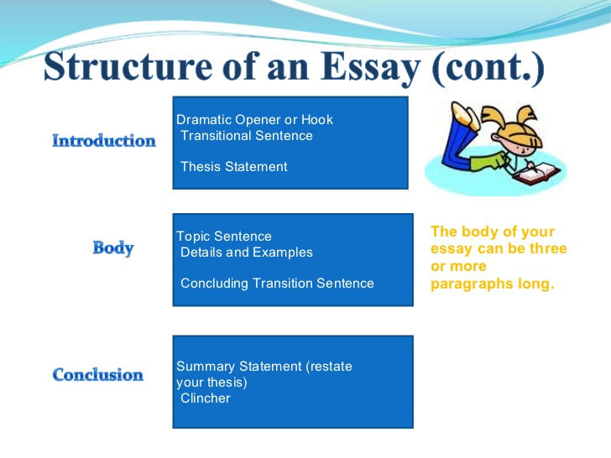

Slide 14

Learning at Home during Lockdown: My Parents and My Teachers
Does technology play a role in making people feel more isolated?
Social media has played a big role in increasing business opportunities.
An experience that changed my life forever.
Universities are becoming business driven.
Write an essay on how advancement in science improve the quality of life for humans.

Slide 15

Dew, E, Stephen(2020). Practical Academic Essay Writing Skills: An International ESL Students English Essay Writing Book (Academic Writing Skills) (Volume 2) 2nd Edition . HBI Cambodia.com
The Beginner’s Guide to writing an Essay retrieved from https://www.scribbr.com/category/academic-essay/

Slide 16


